Slide 1
6
TECHNIQUES OF INTEGRATION

Slide 2
6.1
Integration by Parts

Slide 3
TECHNIQUES OF INTEGRATION
Due to the Fundamental Theorem of Calculus (FTC), we can integrate a function if we know an antiderivative, that is, an indefinite integral.
We summarize the most important integrals we have learned so far, as follows.

Slide 4
FORMULAS OF INTEGRALS

Slide 5
FORMULAS OF INTEGRALS

Slide 6
TECHNIQUES OF INTEGRATION
In this chapter, we develop techniques for using the basic integration formulas.
This helps obtain indefinite integrals of more complicated functions.
We learned the most important method of integration, the Substitution Rule, in Section 4.5.
The other general technique, integration by parts, is presented in Section 6.1

Slide 7
TECHNIQUES OF INTEGRATION
Then, we learn methods that are special to particular classes of functions— such as trigonometric functions and rational functions.

Slide 8
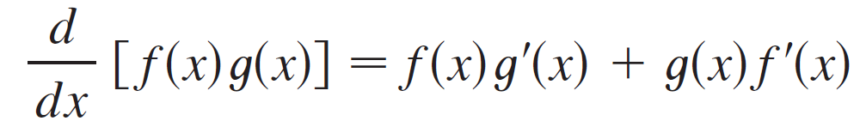
Integration by Parts
Every differentiation rule has a corresponding integration rule. The rule that corresponds to the Product Rule for differentiation is called the rule for integration by parts.
The Product Rule states that if f and g are differentiable functions, then

Slide 9
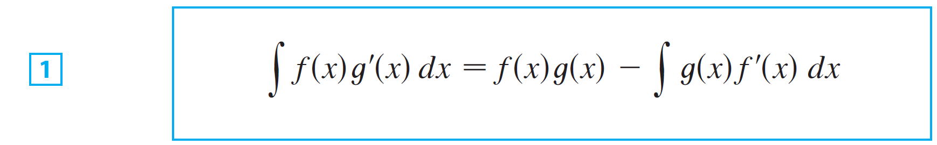
Integration by Parts
In the notation for indefinite integrals this equation becomes
Formula 1 is called the formula for integration by parts.

Slide 10
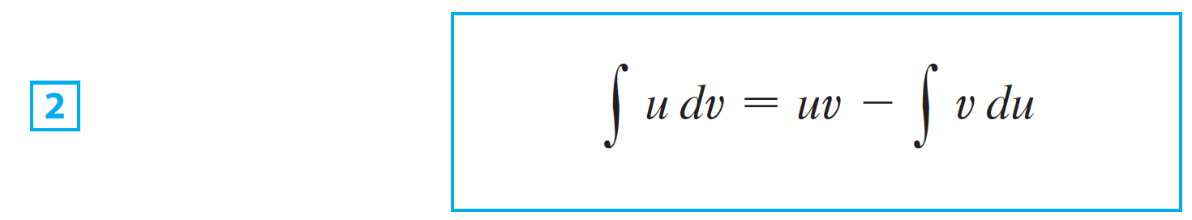
Integration by Parts
It is perhaps easier to remember in the following notation.
Let u = f (x) and v = g(x).
Then the differentials are du = f ′(x) dx and dv = g′(x) dx, so, by the Substitution Rule, the formula for integration by parts becomes

Slide 11
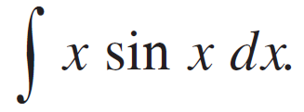
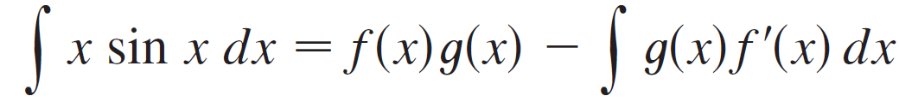
Example 1
Find
SOLUTION:
Using Formula 1 Suppose we choose f (x) = x and
g′(x) = sin x. Then f ′(x) = 1 and g(x) = –cos x. (For g we can choose any antiderivative of g ′.)
Thus, using Formula 1, we have

Slide 12
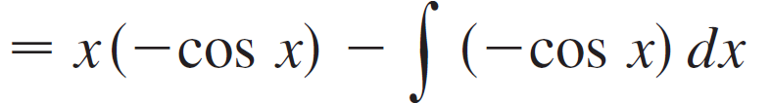
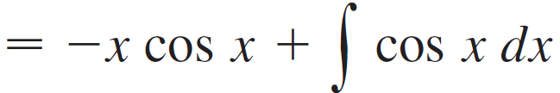

Example 1 – Solution
cont’d
It’s wise to check the answer by differentiating it. If we do so, we get x sin x, as expected.

Slide 13
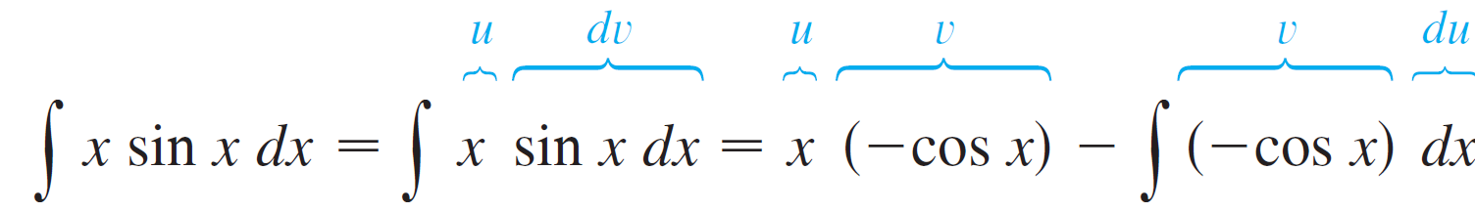
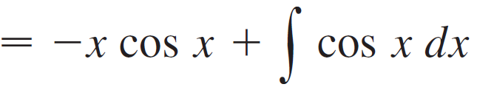
Example 1 – Solution
Using Formula 2 Let
Then
and so
.

Slide 14
NOTE
Our aim in using integration by parts is to obtain a simpler integral than the one we started with.
Thus, in Example 1, we started with and expressed it in terms of the simpler integral

Slide 15
NOTE
If we had instead chosen u = sin x and dv = x dx , then du = cos x dx and v = x²/2.
So, integration by parts gives:
Although this is true, is a more difficult integral than the one we started with.

Slide 16
NOTE
Hence, when choosing u and dv, we usually try to keep u = f(x) to be a function that becomes simpler when differentiated.
At least, it should not be more complicated.
However, make sure that dv = g’(x) dx can be readily integrated to give v.

Slide 17
Example 2
Evaluate
SOLUTION
Here, we don’t have much choice for u and dv.
Let
Then,

Slide 18
Example 2 – Solution
Integrating by parts, we get:
Integration by parts is effective in this example because the derivative of the function f(x) = ln x is simpler than f.

Slide 19
Example 3
Find
SOLUTION
Notice that t² becomes simpler when differentiated.
However, e^{t} is unchanged when differentiated or integrated.

Slide 20
Example 3 – Solution
So, we choose
Then,
Integration by parts gives:
The integral that we obtained, is simpler than the original integral.
However, it is still not obvious.
So, we use integration by parts a second time.

Slide 21
Example 3 – Solution
This time, we choose u = t and dv = e^{t}dt
Then, du = dt, v = e^{t}.
So,

Slide 22
Example 3 – Solution
Putting this in Equation 3, we get where C₁ = – 2C.

Slide 23
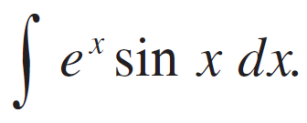

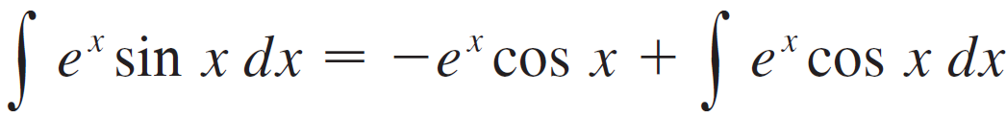
Example 4
Evaluate
SOLUTION:
Neither e^{x} nor sin x becomes simpler when differentiated, but we try choosing u = e^{x} and dv = sin x dx anyway.
Then du = e^{x} dx and v = –cos x, so integration by parts gives

Slide 24


Example 4 – Solution
The integral that we have obtained, is no simpler than the original one, but at least it’s no more difficult.
We integrate by parts again.
This time we use u = e^{x} and dv = cos x dx. Then du = e^{x} dx, v = sin x, and

Slide 25


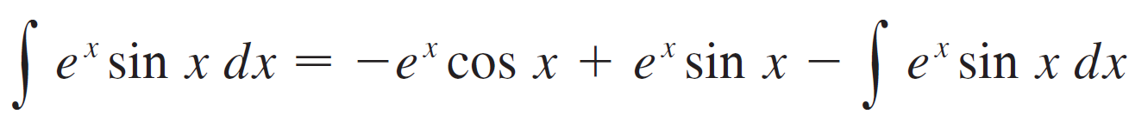
Example 4 – Solution
At first glance, it appears as if we have accomplished nothing because we have arrived at which is where we started.
However, if we put the expression for from Equation 5 into Equation 4 we get
This can be regarded as an equation to be solved for the unknown integral.

Slide 26
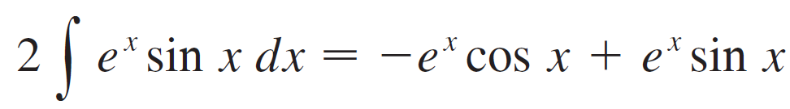
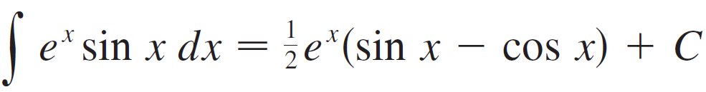
Example 4 – Solution
Adding ∫ e^{x} sin x dx to both sides, we obtain
Dividing by 2 and adding the constant of integration, we get

Slide 27
Example 4 SOLUTION
Figure 1 illustrates Example 4 by showing the graphs of f(x) = e^{x} sin x and F(x) = ½ e^{x}(sin x – cos x).
As a visual check on our work, notice that f(x) = 0 when F has a maximum or minimum.

Slide 28
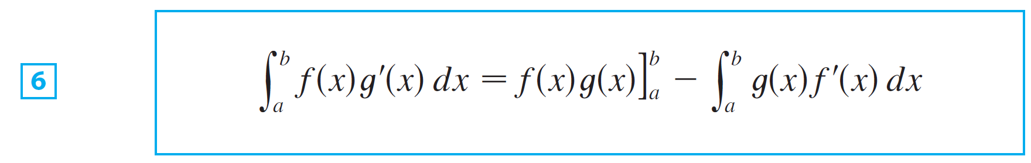
Integration by Parts
If we combine the formula for integration by parts with the Evaluation Theorem, we can evaluate definite integrals by parts.
Evaluating both sides of Formula 1 between a and b, assuming f ′ and g ′ are continuous, and using the Evaluation Theorem, we obtain

Slide 29
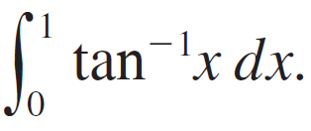
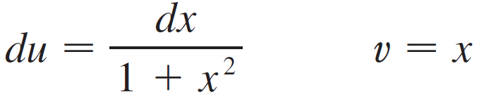
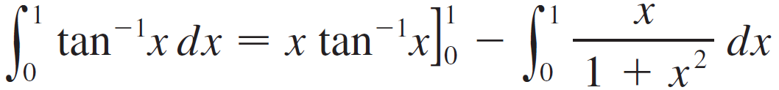
Example 5
Calculate
SOLUTION:
Let
Then
So Formula 6 gives

Slide 30
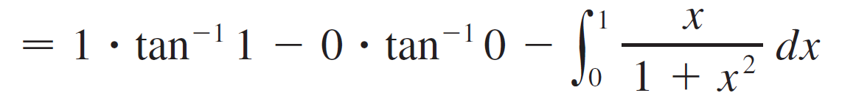
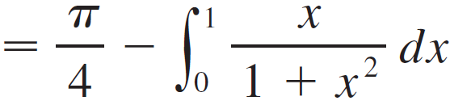
Example 5 – Solution
To evaluate this integral we use the substitution t = 1 + x² (since u has another meaning in this example).
Then dt = 2x dx, so x dx = dt. When x = 0, t = 1; when x = 1, t = 2; so

Slide 31

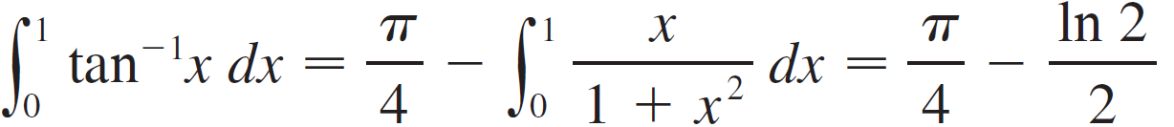
Example 5 – Solution
Therefore

Slide 32
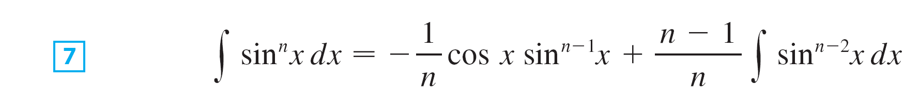
Integration by Parts
We can prove the following reduction formula using Integration by parts.
Reduction Formula:
where n ≥ 2 is an integer.

Slide 33
Example 6
Prove the reduction formula where n ≥ 2 is an integer.
This is called a reduction formula because the exponent n has been reduced to n – 1 and n – 2.

Slide 34
Example 6 – Solution
Let
Then,
So, integration by parts gives:

Slide 35
Example 6 – Solution
Since cos²x = 1 – sin²x, we have:
As in Example 4, we solve this equation for the desired integral by taking the last term on the right side to the left side.

Slide 36
Example 6 – Solution
Thus, we have: or

Slide 37
INTEGRATION BY PARTS
The reduction formula (7) is useful.
By using it repeatedly, we could express in terms of:
(if n is odd)
(if n is even)

